Slide 1




PBL REVIEW-4 • RESULTS & ANALYSIS
ACADEMIC YEAR 2026
COURSE: 25CS1302E – DBE & DSD
Financial Risk Analytics with Polyglot Data Engineering
Hybrid Relational & NoSQL Architecture for Real-Time Financial Risk Assessment, High-Throughput Processing, and Secure REST API Services.
Polyglot Persistence Layer
PostgreSQL (ACID) + MongoDB (Flex Docs)
PROJECT & GROUP
TEAM MEMBERS
FACULTY MENTOR & DEPT
Project 6 • Group 16
Utkalika • Divya Sri • Ambika • Kavitha
Melinda • Dept. of AI & DS

Slide 2








CORE GOALS & VISION
Project Objectives
Architectural goals driving our dual-database financial risk analytics platform.
Structured Financial Data
Transaction Integrity
Flexible Risk Data
Backend REST APIs
Manage customer accounts, balances, and ledger transactions accurately.
Maintain strict ACID compliance for transactional ledger data in PostgreSQL.
Store complex, unstructured risk analytics in MongoDB documents.
Provide fast, standardized API endpoints using FastAPI architecture.
Secure Auth System
Risk Assessment
Reports & Alerts
Unified Platform
Implement role-based access control and JWT token authentication.
Calculate live risk scores and evaluate anomaly indicators.
Generate automated financial reports and high-risk flags.
Seamlessly integrate web dashboard with polyglot backend data layer.

Slide 3

ENGINEERING LIFECYCLE
From Idea to Working System
Structured 10-stage execution plan highlighting polyglot database implementation.
STEP 01
STEP 02
STEP 03
STEP 04
STEP 05
Problem ID
Requirements
Database Design
Backend Dev
API Development
STEP 10
STEP 09
STEP 08
STEP 07
STEP 06
Final System
System Testing
Risk Analytics
DB Integration
Frontend Dev
Polyglot Database Dual-Implementation Achieved
PostgreSQL handles strict transactional financial records (Customers, Accounts, Ledgers), while MongoDB stores semi-structured, high-velocity Risk Analysis reports simultaneously.

Slide 4
TOOLING & ENVIRONMENT
Technology Stack & Implementation
Connected technology layers powering the financial analytics engine.
Database Layer
DB Connectivity
Backend Framework
PostgreSQL: Structured Financial Records
psycopg2: PostgreSQL Python Adapter
Python 3.x: Core Business Logic Engine
MongoDB: Flexible Risk-Analysis Documents
PyMongo: Native MongoDB Driver
FastAPI: High-performance REST APIs
API & Security
Frontend Dashboard
Dev Environment
REST API: Standardized JSON Endpoints
HTML5 & CSS3: Responsive UI Layouts
VS Code: Primary IDE & Debugger
JWT Token: Stateful & Secure Authentication
JavaScript (ES6): Async Fetch & DOM Control
Localhost Environment: Python venv

Slide 5
SYSTEM BLUEPRINT
System Architecture
End-to-end data pipeline connecting client interactions to polyglot storage engines.
Client Web UI
FastAPI Backend Services
HTML / CSS / JS Dashboard
JWT Auth • Request Validation • Business Rules
POLYGLOT DATABASE PERSISTENCE LAYER
PostgreSQL (Relational)
MongoDB (NoSQL Document)
Customer • Account • Transaction
risk_analysis Collection
ACID / Strict Consistency
Flexible Schema Documents
Analytics Engine generates live risk score, alerts, & dynamic reporting response

Slide 6
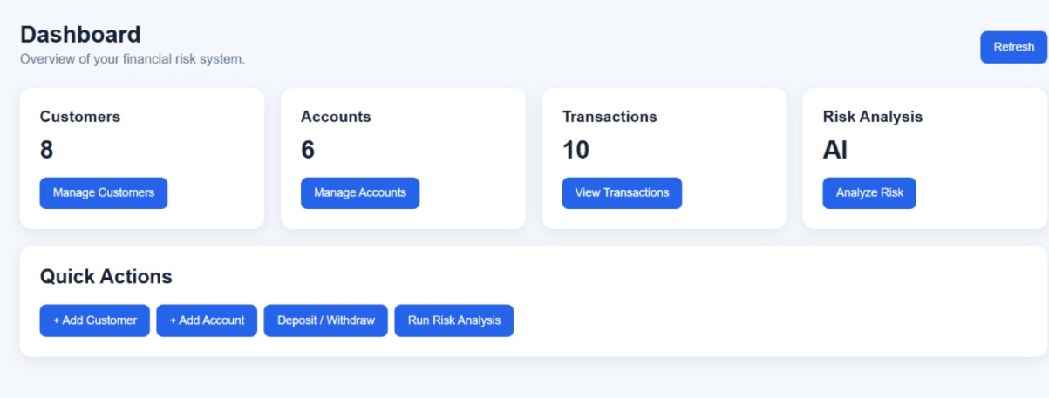
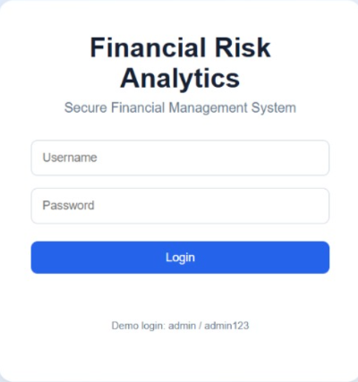
SYSTEM SCREENSHOTS
Working Demonstration
Verified interface components and operational application views.
Login View
Home Page
Financial Form

Slide 7
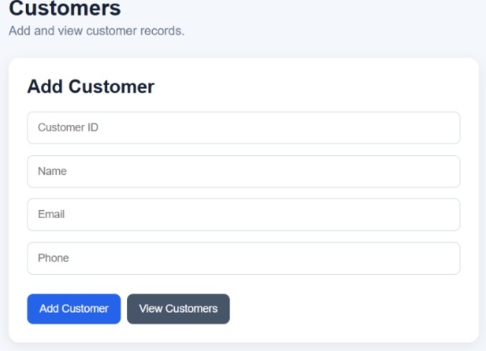
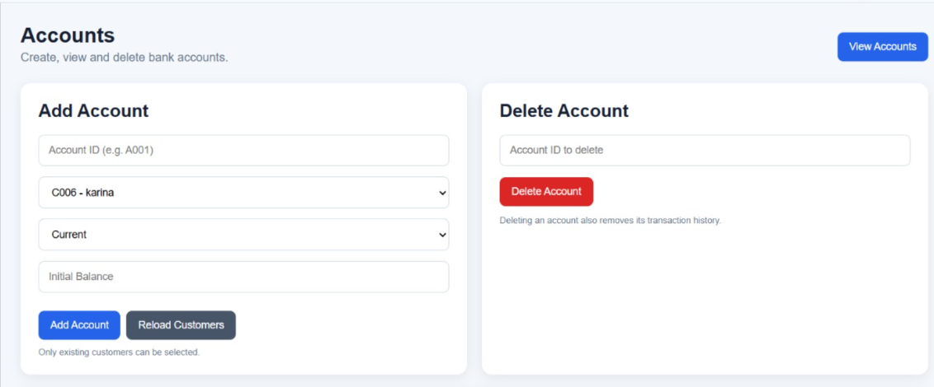
SYSTEM SCREENSHOTS
Working Demonstration
Verified interface components and operational application views.
Customer View
Accounts Page

Slide 8
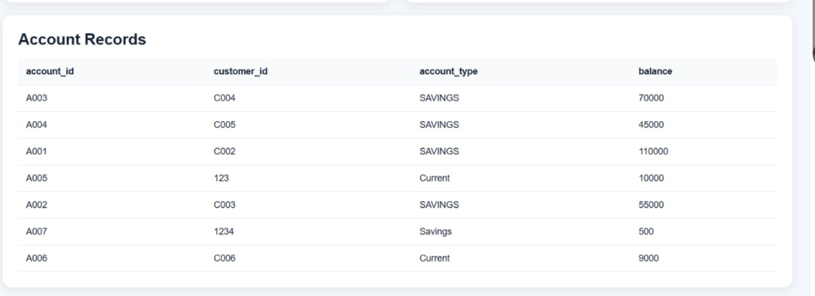
SYSTEM SCREENSHOTS
Working Demonstration
Verified interface components and operational application views.
Output Page

Slide 9
FEATURE MATRIX
What Can the System Actually Do?
Implemented and functional capabilities across core application modules.
Authentication
Customer Management
Account Management
User Signup & Secure Login
Add Customer Profiles
Create & Bind Financial Accounts
JWT Token-based Auth
View, Update, Delete Records
Fetch & Update Account States
Transactions
Risk Analytics
API Connectivity
Process Ledger Transactions
Compute Live Risk Scores
Async Fetch Frontend REST Calls
Query Transaction Histories
Store Document Reports in Mongo
Polyglot Routing & Drivers

Slide 10
POLYGLOT STORAGE STRATEGY
Database Implementation in Action
Decoupled data handling optimized for operational integrity and analytical flexibility.
POSTGRESQL (SQL)
financial_risk_db
MONGODB (NoSQL)
financial_risk_db
Tables: Customer, Account, Transaction
Collection: risk_analysis
Key Rules: Primary/Foreign Key Constraints
Format: Dynamic BSON/JSON Documents
Guarantees: Strong ACID & Referential Integrity
Advantage: Flexible schema for dynamic flags
Frontend
Backend Router
PostgreSQL (Relational Requests)
MongoDB (Risk Logs)
“Polyglot persistence allows each database to handle the workload it is best suited for.”

Slide 11
TECHNICAL EVALUATION
Results & Analysis
Summary of operational outcomes across system architecture tiers.
Database Persistence
Backend API Services
PostgreSQL successfully manages structured financial records with zero integrity violations. MongoDB provides dynamic storage for risk assessment documents.
REST APIs successfully handle asynchronous requests, validating incoming data payloads and routing operations to correct persistence layers.
Security & Access Control
Risk Analytics Engine
Role-based authentication protects controlled endpoints. JWT tokens prevent unauthorized API access across financial operations.
Risk scoring algorithm processes transaction velocity and account metrics, successfully storing output in MongoDB risk collections.
OVERALL PROJECT EVALUATION
[INSERT FINAL PROJECT RESULT / OBSERVATION]
Final System Result & Observations

Slide 12
DATA LIFECYCLE
One Complete Request — End to End
Tracing a single financial risk transaction request through the system pipeline.
1
Frontend Form Submit: User triggers risk calculation from Web Dashboard.
2
JWT Validation: API gateway verifies user token and authorization header.
3
PostgreSQL Query: Backend queries transactional history and customer balance.
4
Risk Evaluation: Analytics module calculates risk score and flags indicators.
5
MongoDB Storage & API Response: Analysis logged to Mongo; JSON response rendered on dashboard.

Slide 13
MILESTONES REACHED
What We Successfully Built
Summary of completed engineering deliverables for Review-4.
Polyglot Architecture
PostgreSQL Integration
MongoDB Integration
Successfully unified SQL and NoSQL engines within a single system.
Relational tables configured with constraints and transaction support.
NoSQL document storage for high-volatility risk analysis objects.
Backend API Layer
JWT Authentication
Frontend Integration
Standardized REST endpoints for CRUD and analytics actions.
Protected API endpoints and user session management.
Interactive dashboard providing visual feedback and reporting UI.

Slide 14

Thank You!
Financial Risk Analytics with Polyglot Data Engineering
PROJECT TEAM
Utkalika • Divya Sri • Ambika • Kavitha

